Slide 1

19/03/2025
Predicting customer buying behavior

Slide 2
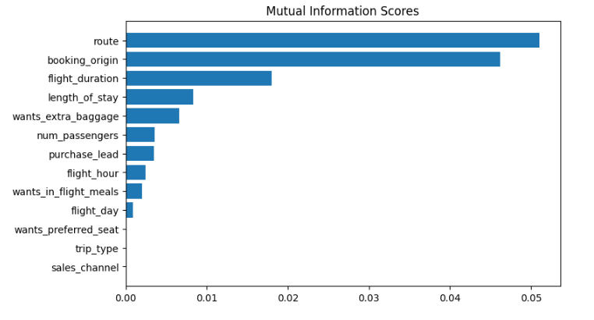
predictive model to understand factors that influence buying behavior
We have trained this data set with 2 different models and got random forest classifier having more ACCURACY and AUC score
ACCURACY: 85.09
AUC score: 0.558
Route
Booking origin
Flight duration
Wants extra baggage
Length of stay
are the top 5 features which influence
Customer buying behavior
We need to increase the AUC score.

